Slide 1
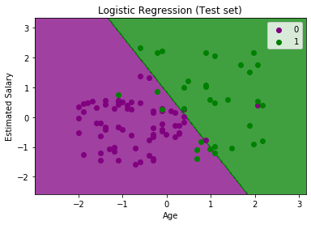
Logistic regression

Slide 2
Goals to cover:
Regression
Types of regression
Logistic regression

Slide 3
Regression?
Definition:
Regression is a statistical method that attempts to determine the strength and character of the relationship between corelated variables where one is dependent variable (unknown variable usually denoted by Y) and another one is one/series of other independent variables/factor (known variable usually denoted by X).
Examples :
independent variables(x) : season, no. of employee, month
dependent variables(y) : amount of rice production, annual sales, rainfall
Synonyms of variable : characteristic/variant/factor/features

Slide 4
Types of Regression:
Linear Regression
Logistic Regression
Polymorphic Regression

Slide 5
Question
Email is span or not? Yes/No
Which party will win the election? Congress/Yamale/Maubadi/Daparba

Slide 6
Question
Email is span or not? Yes/No
Which party will win the election? Congress/Yamale/Maubadi/Daparba
Answer
Logistic Regression

Slide 7
Logistic Regression
Logistic regression is one of the most popular Machine learning algorithm/technique that comes under Supervised Learning techniques which use labeled dataset to make the predictions of Categorical value and solve Classification as well as for Regression problems, but mainly used for Classification problems.

Slide 8
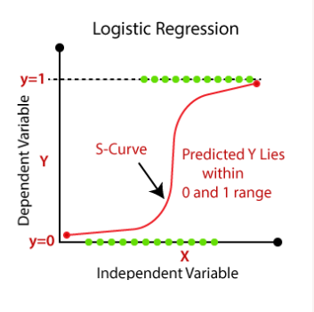

Slide 9
Types of Logistic Regression
Binary Classification
Multiclass Classification
Email is span or not?
Yes/No, 0/1, True/False, High/Low (Binary Classification)
Which party will win the election?
Congress/Yamale/Maubadi/Daparba
More than two categories -> (Multiclass Classification)

Slide 10
Facts of Logistic Regression:
This algorithm classifies in which category it belong?
Taking example of email spam checking, the independent factors for email span checking are Talking about money, How often it send email, Location ?
Note Term : Sigmoid Function, Probability, S-curve

Slide 11
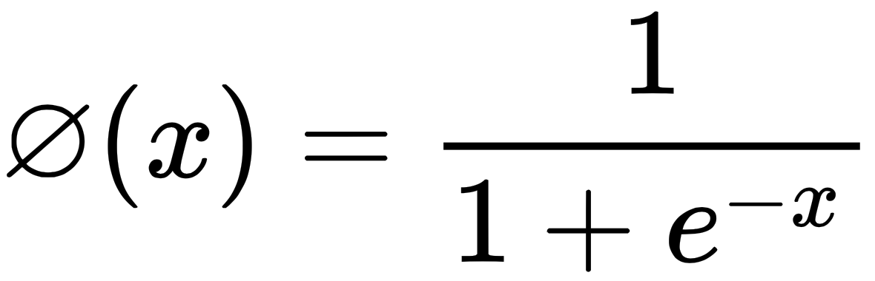
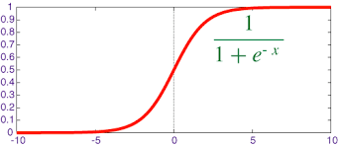
Sigmoid Function
S-Curve

Slide 12
Facts of Logistic Regression:
Linear regression gives value of Y(Dependent variable).We will squeeze that value into 1-0 range by keeping that value into a special function. That special function is called sigmoid function.
Here,
Logistic regression gives probability value using Sigmoid Function.
Logistic regression takes trained dataset, fit linear model(gives value), squeeze that value using sigmoid function, gives probability, finally gives logistic result ( 0 - 0.5 - 1 ).
If Probability > 0.5 or 50% , its 1
If Probability < 0.5 or 50% , its 0
0 0.5 1
Low Thresold_Value High

Slide 13
Additional Note :
We can run logistic regression using in python library sklearn, numbpy.
Thank You !

